Slide 1
Pangenomics lab notebook

Slide 2
Pangenomics
No gene clusters or KOs are statistically enriched between tissues after running anvi-compute-functional-enrichment-in-pan on the assemblies
Will rerun on just the qced bins once that is done

Slide 3
Megahit binning
Weird results here, got several bins for each sample. For the most part, each bin was too small to be a good assembly of b. breve. In most samples all the bins added together would be about the size of genome we want.
Redid the workflow using spades, which is more memory intensive but known to give longer assemblies.

Slide 4
Spades binning
Resulted in generally shorter and bins with no taxonomic classifications (generally worse than megahit). I think I might rerun with the scaffolds.fa output. Though I am not sure if this is the proper input. The documentation on spades says it is the primary down stream output, but most forum posts, i.e. use contigs. Anvio mg workflow also uses contigs by default but states one can use the scaffolds.
Ran concoct on the contigs from spades and they did not look good at all. Might be because landon did it wrong, not sure.

Slide 5
Enrichments in spades assemblies
No enriched kofams or pfams in the spades assembly q

Slide 6
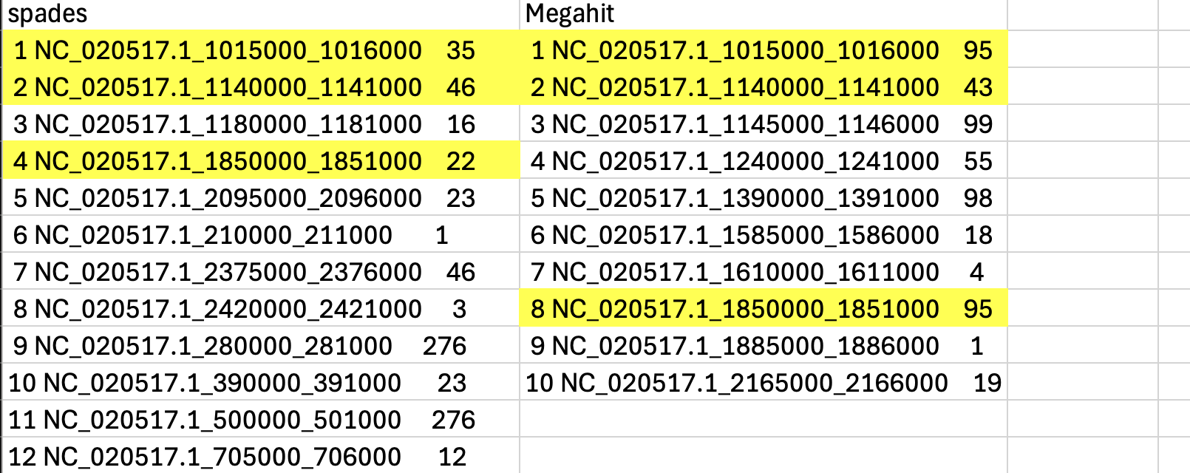
Syntracker
By and large the syntracker results are not robust to different subsampling depths or assemblies, the results look similar at a genome wide level. This may indicate that there are only certain regions undergoing rearrangement
Some regions are shared between assemblers (that is they region apsses below the same strain cutoff. This could be due to technical reasons or biology. Not sure.

Slide 7
Checking binning process (metabat2)
Binnig with the anvi converage produces smaller (and likely worse bins)
Standard output:
2 bins (2,333,080 bases in total) formed. (standard output)
Using anvio supplied coverage file
2 bins (2,141,101 bases in total) formed.
Updating pipeline to include this step

